Slide 1
LESSON -2

Slide 2
Numerical Presentation
A fundamental concept in summary statistics is that of a central value for a set of observations and the extent to which the central value characterizes the whole set of data. Measures of central value such as the mean or median must be coupled with measures of data dispersion (e.g., average distance from the mean) to indicate how well the central value characterizes the data as a whole.
To understand how well a central value characterizes a set of observations, let us consider the following two sets of data:
  A: 30, 50, 70
  B: 40, 50, 60
The mean of both two data sets is 50. But, the distance of the observations from the mean in data set A is larger than in the data set B. Thus, the mean of data set B is a better representation of the data set than is the case for set A.

Slide 3
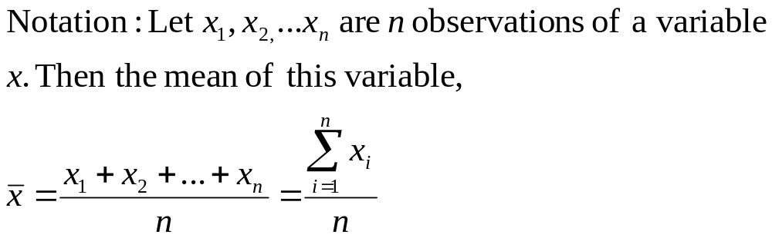
Methods of Center Measurement
Center measurement is a summary measure of the overall level of a dataset
Commonly used methods are mean, median, mode, geometric mean etc.
Mean: Summing up all the observation and dividing by number of observations. Mean of 20, 30, 40 is (20+30+40)/3 = 30.

Slide 4
Methods of Center Measurement
Median: The middle value in an ordered sequence of observations. That is, to find the median we need to order the data set and then find the middle value. In case of an even number of observations the average of the two middle most values is the median. For example, to find the median of {9, 3, 6, 7, 5}, we first sort the data giving {3, 5, 6, 7, 9}, then choose the middle value 6. If the number of observations is even, e.g., {9, 3, 6, 7, 5, 2}, then the median is the average of the two middle values from the sorted sequence, in this case, (5 + 6) / 2 = 5.5.
Mode: The value that is observed most frequently. The mode is undefined for sequences in which no observation is repeated.

Slide 5
Mean or Median
The median is less sensitive to outliers (extreme scores) than the mean and thus a better measure than the mean for highly skewed distributions, e.g. family income. For example mean of 20, 30, 40, and 990 is (20+30+40+990)/4 =270. The median of these four observations is (30+40)/2 =35. Here 3 observations out of 4 lie between 20-40. So, the mean 270 really fails to give a realistic picture of the major part of the data. It is influenced by extreme value 990.

Slide 6
Methods of Variability Measurement
Variability (or dispersion) measures the amount of scatter in a dataset.
Commonly used methods: range, variance, standard deviation, interquartile range, coefficient of variation etc.
Range: The difference between the largest and the smallest observations. The range of 10, 5, 2, 100 is (100-2)=98. It’s a crude measure of variability.

Slide 7
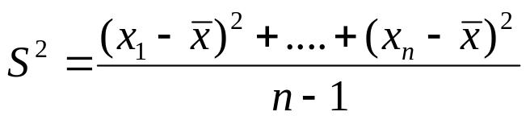
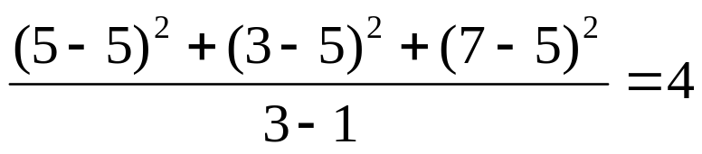
Methods of Variability Measurement
Variance: The variance of a set of observations is the average of the squares of the deviations of the observations from their mean. In symbols, the variance of the n observations x₁, x₂,…x_{n} is
Variance of 5, 7, 3? Mean is (5+7+3)/3 = 5 and the variance is
Standard Deviation: Square root of the variance. The standard deviation of the above example is 2.

Slide 8
Methods of Variability Measurement
Quartiles: Data can be divided into four regions that cover the total range of observed values. Cut points for these regions are known as quartiles.
In notations, quartiles of a data is the ((n+1)/4)q^{th} observation of the data, where q is the desired quartile and n is the number of observations of data.
The first quartile (Q1) is the first 25% of the data. The second quartile (Q2) is between the 25th and 50th percentage points in the data. The upper bound of Q2 is the median. The third quartile (Q3) is the 25% of the data lying between the median and the 75% cut point in the data.
Q1 is the median of the first half of the ordered observations and Q3 is the median of the second half of the ordered observations.

Slide 9
Methods of Variability Measurement
In the following example Q1= ((15+1)/4)1 =4th observation of the data. The 4th observation is 11. So Q1 is of this data is 11.
An example with 15 numbers
3 6 7 11 13 22 30 40 44 50 52 61 68 80 94 Q1 Q2 Q3
The first quartile is Q1=11. The second quartile is Q2=40 (This is also the Median.) The third quartile is Q3=61.
Inter-quartile Range: Difference between Q3 and Q1. Inter-quartile range of the previous example is 61- 40=21. The middle half of the ordered data lie between 40 and 61.

Slide 10
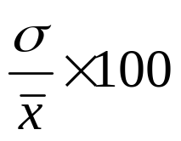
Deciles and Percentiles
Deciles: If data is ordered and divided into 10 parts, then cut points are called Deciles
Percentiles: If data is ordered and divided into 100 parts, then cut points are called Percentiles. 25th percentile is the Q1, 50th percentile is the Median (Q2) and the 75th percentile of the data is Q3.
In notations, percentiles of a data is the ((n+1)/100)p th observation of the data, where p is the desired percentile and n is the number of observations of data.
Coefficient of Variation: The standard deviation of data divided by it’s mean. It is usually expressed in percent.
Coefficient of Variation =

Slide 11
Five Number Summary
Five Number Summary: The five number summary of a distribution consists of the smallest (Minimum) observation, the first quartile (Q1),
The median(Q2), the third quartile, and the largest (Maximum) observation written in order from smallest to largest.
Box Plot: A box plot is a graph of the five number summary. The central box spans the quartiles. A line within the box marks the median. Lines extending above and below the box mark the smallest and the largest observations (i.e., the range). Outlying samples may be additionally plotted outside the range.

Slide 12
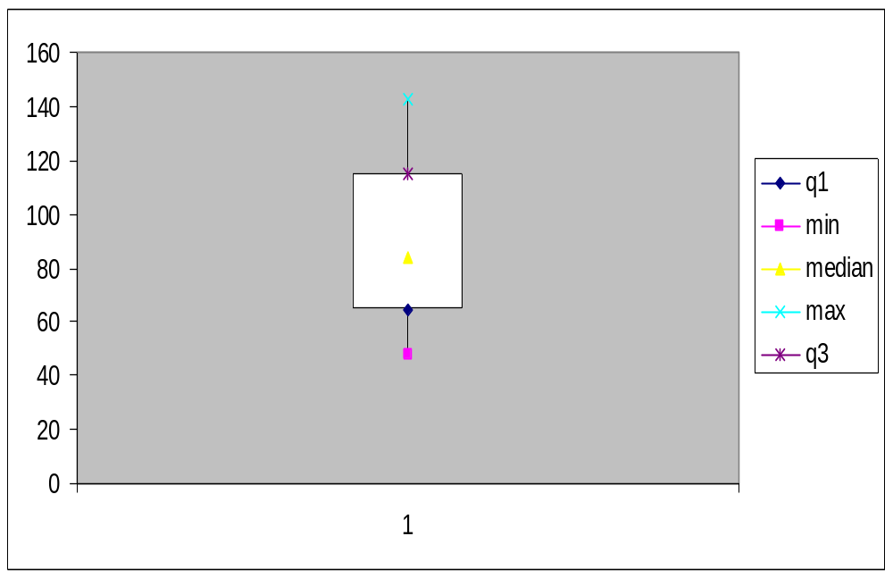
Boxplot
Distribution of Age in Month

Slide 13
Choosing a Summary
The five number summary is usually better than the mean and standard deviation for describing a skewed distribution or a distribution with extreme outliers. The mean and standard deviation are reasonable for symmetric distributions that are free of outliers.
In real life we can’t always expect symmetry of the data. It’s a common practice to include number of observations (n), mean, median, standard deviation, and range as common for data summarization purpose. We can include other summary statistics like Q1, Q3, Coefficient of variation if it is considered to be important for describing data.

Slide 14
Shape of Data
Shape of data is measured by
  Skewness
  Kurtosis

Slide 15
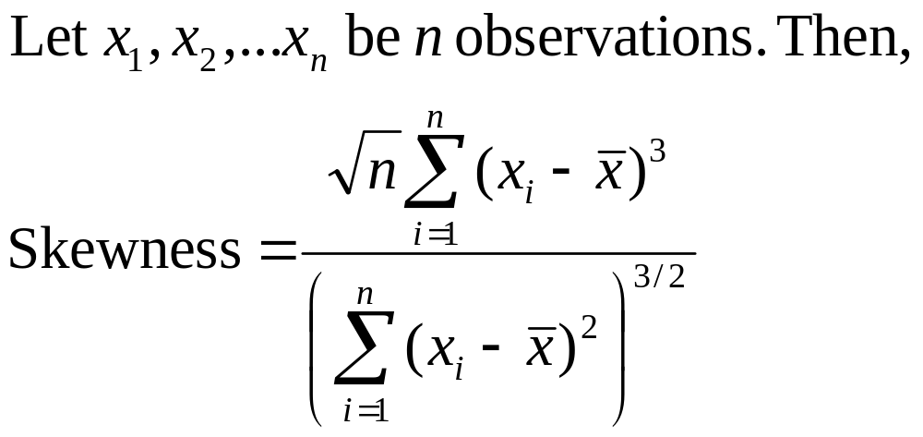
Skewness
Measures asymmetry of data
  Positive or right skewed: Longer right tail
  Negative or left skewed: Longer left tail

Slide 16
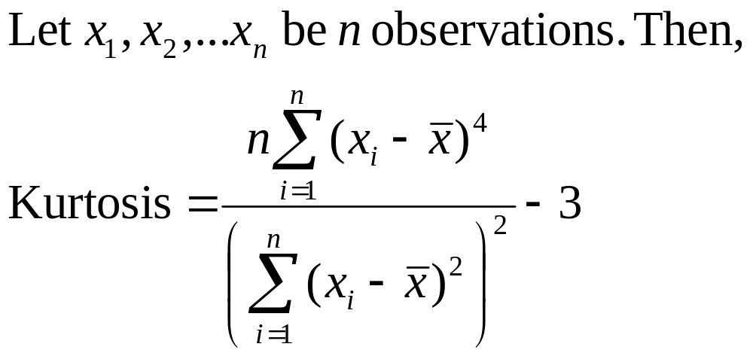
Kurtosis
Measures peakedness of the distribution of data. The kurtosis of normal distribution is 0.

Slide 17
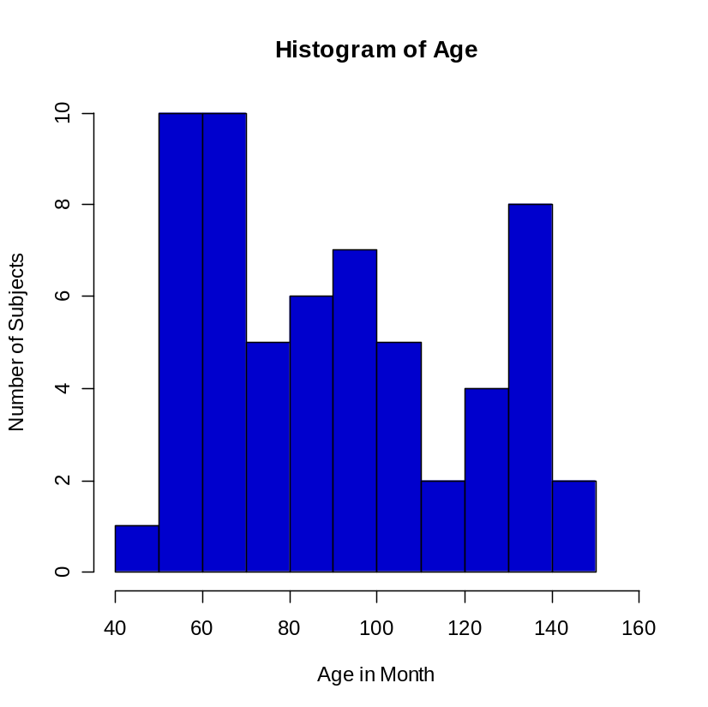
Summary of the Variable ‘Age’ in the given data set
Mean | 90.41666667
Standard Error | 3.902649518
Median | 84
Mode | 84
Standard Deviation | 30.22979318
Sample Variance | 913.8403955
Kurtosis | -1.183899591
Skewness | 0.389872725
Range | 95
Minimum | 48
Maximum | 143
Sum | 5425
Count | 60

Slide 18
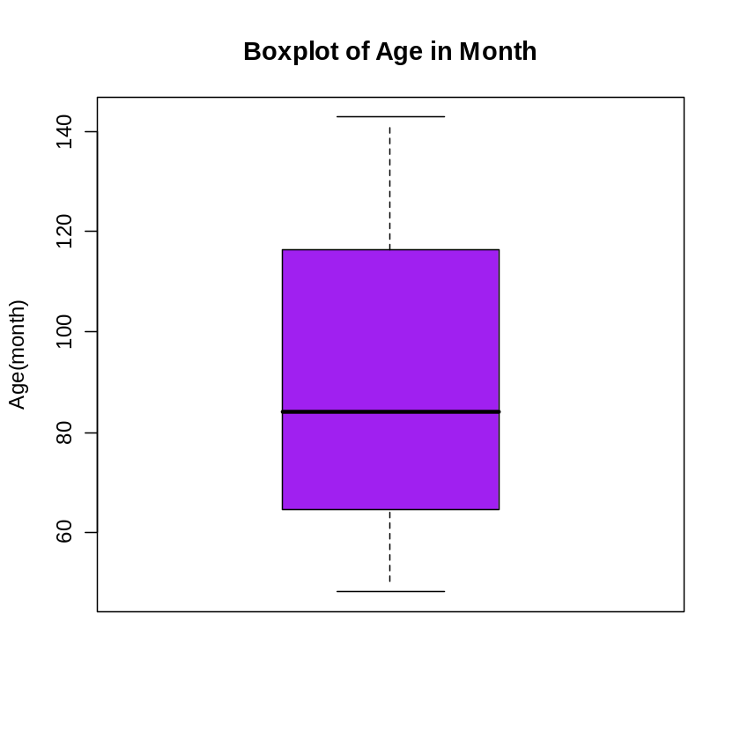
Summary of the Variable ‘Age’ in the given data set

Slide 19
Class Summary (First Part)
So far we have learned-
Statistics and data presentation/data summarization
Graphical Presentation: Bar Chart, Pie Chart, Histogram, and Box Plot
Numerical Presentation: Measuring Central value of data (mean, median, mode etc.), measuring dispersion (standard deviation, variance, co-efficient of variation, range, inter-quartile range etc), quartiles, percentiles, and five number summary
Any questions ?

